Slide 1
Raveendiran RR
Over 18 + years of overall experience in the IT Industry
Roles :
DevOps | App Development| CoE | Low-code No-code| SAP BTP | SAP Build Apps | Chatbots | Project management | SAP ERP/SuccessFactors support +Implementation | Generative AI | Machine Learning
Passionate about technology and innovation
LinkedIn

Slide 2
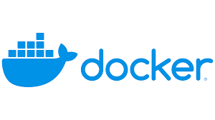
Containers rule …..
Docker is cool !!!!

Slide 3
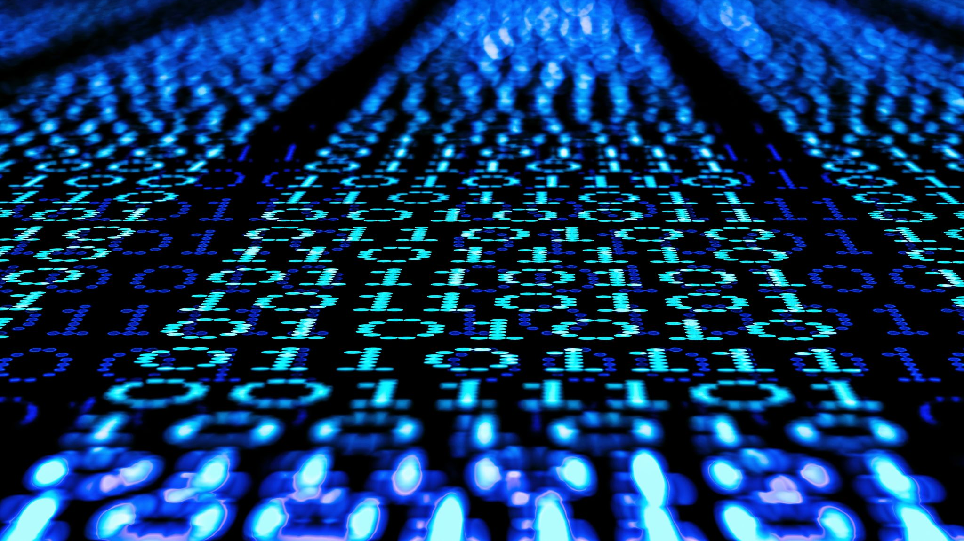
Generative AI 102
By Raveendiran RR

Slide 4
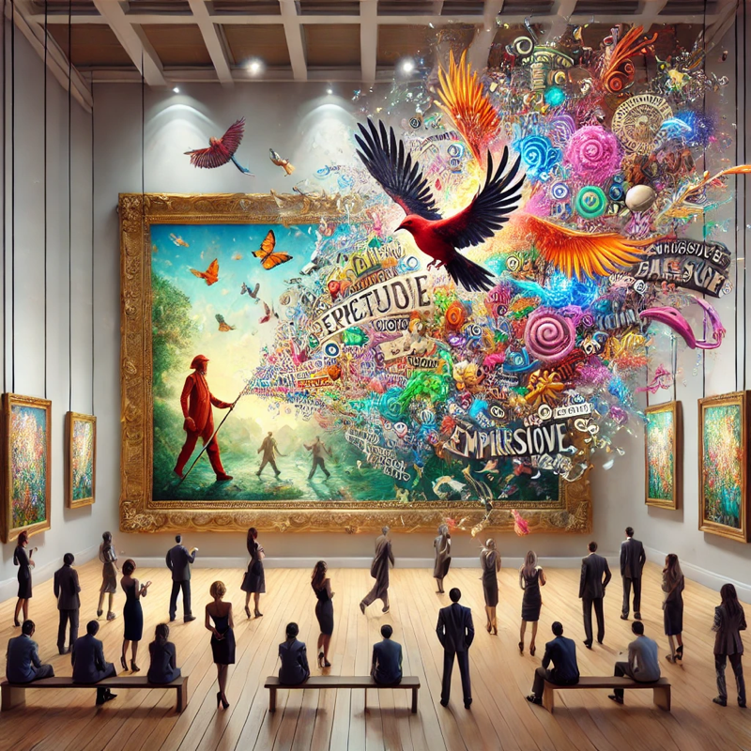
What you we will explore today

Slide 5
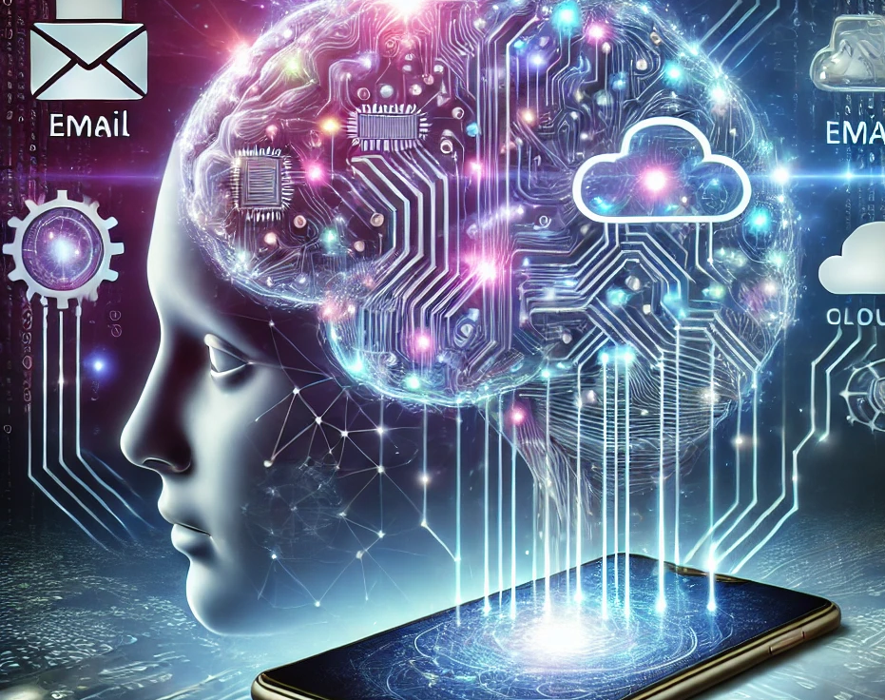
Recap of Generative AI 101

Slide 6
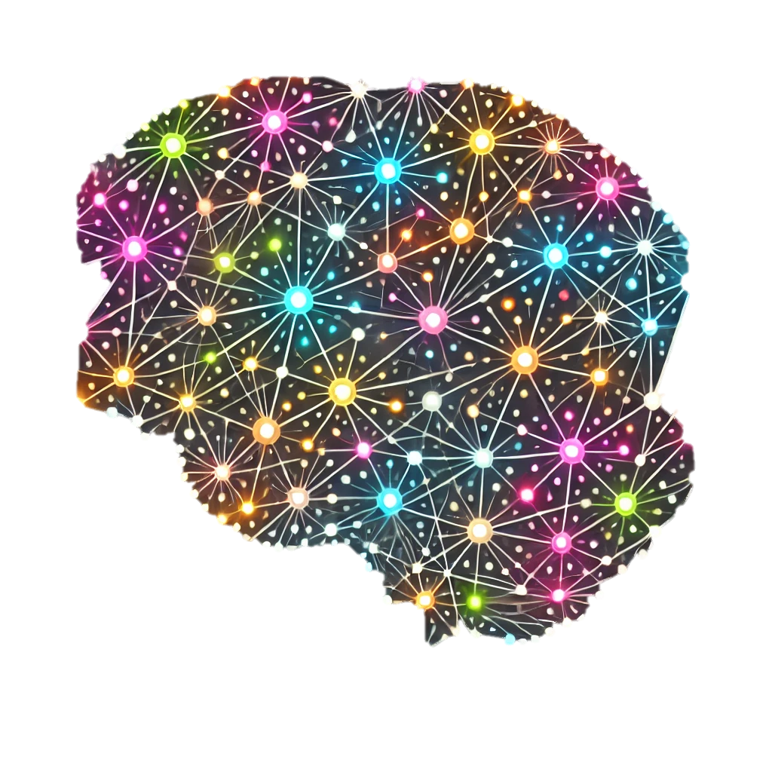
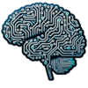
Introduction to AI and Generative AI
Artificial Intelligence
Machine Learning
Neural Networks | Deep Learning
Generative AI
Refers to the simulation of human intelligence in machines programmed to think and learn like humans.
Generates Text | Images | Videos | Audio | Code Based on pre-trained information it has been trained on
Discriminative vs Generative
Machine Learning (ML) is a subset of AI that focuses on enabling machines to learn from data without being explicitly programmed. ML algorithms improve their performance as they process more data
Neural networks are computational models inspired by the brain’s neurons; deep learning uses multiple neural layers to learn from data
Notes:
**Machine Learning** Supervised learning, unsupervised learning, reinforcement learning. Spam filtering, recommendation systems, predictive analytics.

Slide 7
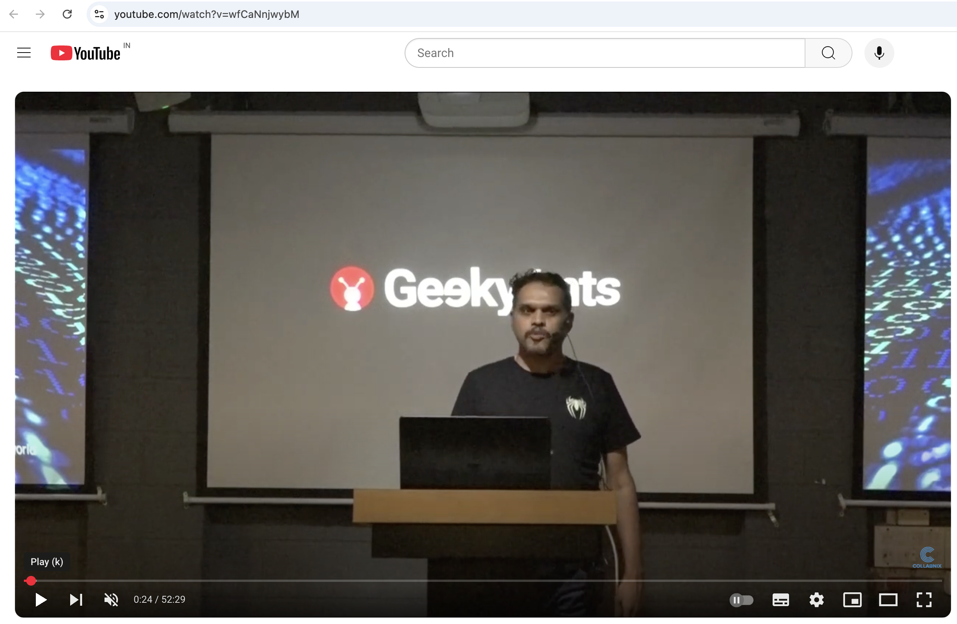
Introduction to AI and Generative AI
https://www.youtube.com/watch?v=wfCaNnjwybM
Notes:
**Machine Learning** Supervised learning, unsupervised learning, reinforcement learning. Spam filtering, recommendation systems, predictive analytics.

Slide 8
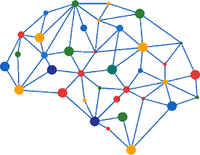
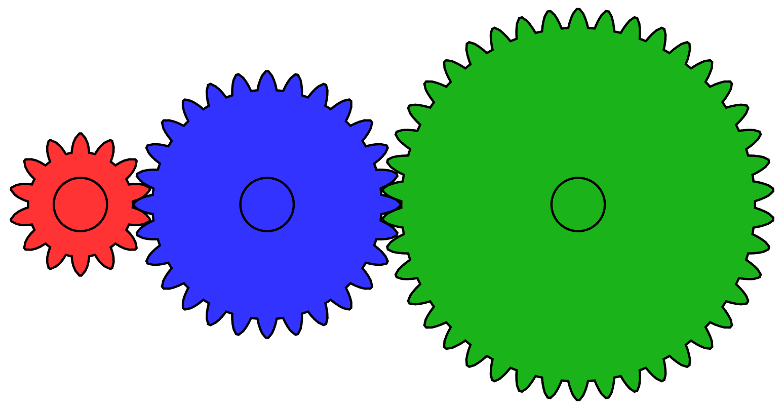
Introduction to AI
AI Systems – Rule based
AI
Un Supervised Learning
Reinforcement Learning
Supervised learning
ML

Slide 9
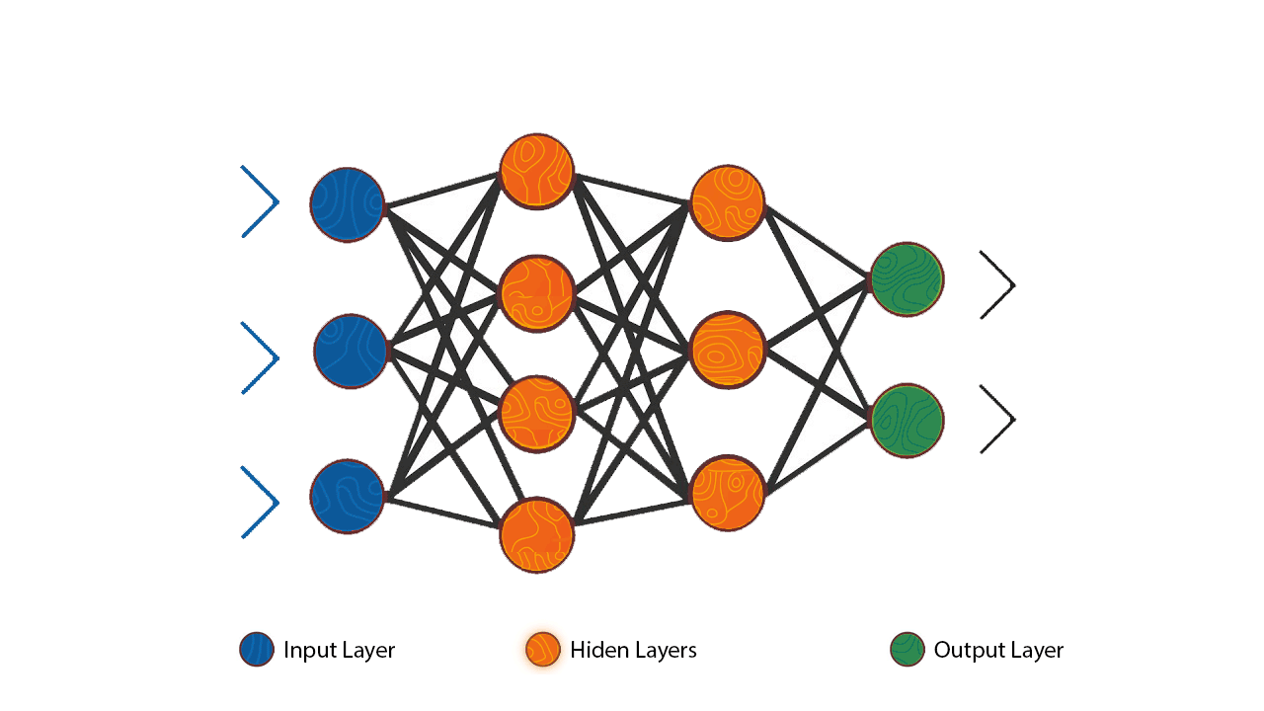
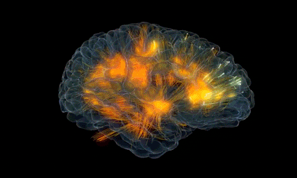
Introduction to AI
Neural Network | Deep Learning
Connected nodes with layers
forming a neural network
Neural networks in the Brain
Node
Fx | Wt
Connection | Rules
Transformers
Input = Encoders | Output = Decoders
Reference : https://jalammar.github.io/illustrated-transformer/

Slide 10
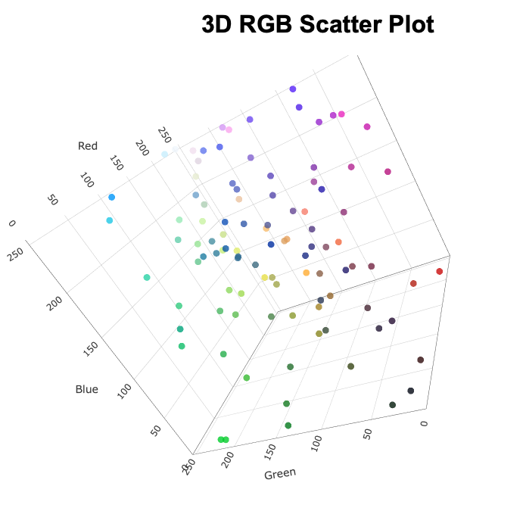
Introduction to AI
how does an AI system understand and process data to provide information ?
1. Encode all the human readable input as vectors
2. Observes and learns from the patterns on how a task is performed to predict output
3. Decode the output from vectors to text
Example : 1. The picture on the right shows a 3-Dimensional Graph
2. It has 3 Axis representing the colors RED | GREEN | BLUE
3. When the value of RGB changes, the color on the ball's changes accordingly

Slide 11
Introduction to AI
Input Your Text:
Simply provide the text you want to process
Smart Chunking:
Break it down into smaller, manageable words
Vector Encoding:
Each word and letter is converted into vectors with assigned weights and functions.
LLM Processing:
Cutting-edge Large Language Model (LLM) takes over, using neural networks to process the encoded information.
Generate Output:
The LLM produces output in the form of vectors.
Decode to Text:
Convert these vectors back into clear, understandable text for you.

Slide 12
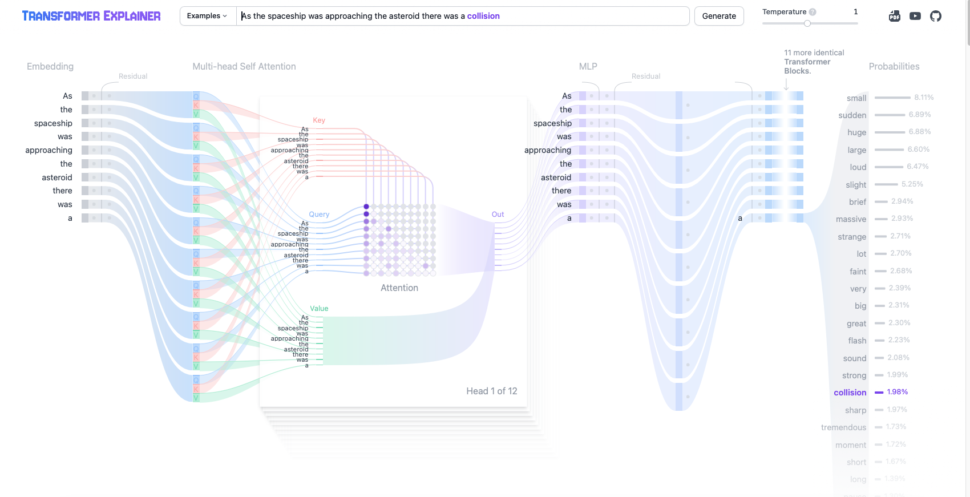
Introduction to AI
Example of how transformers are used to predict information ?
https://poloclub.github.io/transformer-explainer/

Slide 13
Generative AI Capabilities
Generative AI
Text
Audio
Video | Images
Articles
Whitepapers
Code
Speech to Text
Text to Speech
Clone Voice
Text to video
Generative AI

Slide 14
When to use AI
1. Automating Repetitive Tasks
Use AI tools to automate routine and time-consuming tasks such as data entry, scheduling, or sorting emails. This frees up human resources for more complex and creative work.
2. Analyzing Large Datasets
When dealing with vast amounts of data that are impractical to analyze manually, AI can quickly identify patterns, trends, and insights, aiding in data-driven decision-making.
3. Enhancing Decision-Making
Utilize AI for predictive analytics and risk assessment to support complex decision-making processes. AI can simulate scenarios and provide recommendations based on historical data.
4. Personalizing User Experiences
AI tools are effective in customizing content, product recommendations, or services based on individual user behavior and preferences, thereby improving customer satisfaction and engagement.
5. Improving Accuracy and Efficiency
Implement AI to reduce human error and increase efficiency in tasks like quality control, medical diagnostics, or demand forecasting. AI systems can process information consistently and accurately at high speeds.

Slide 15
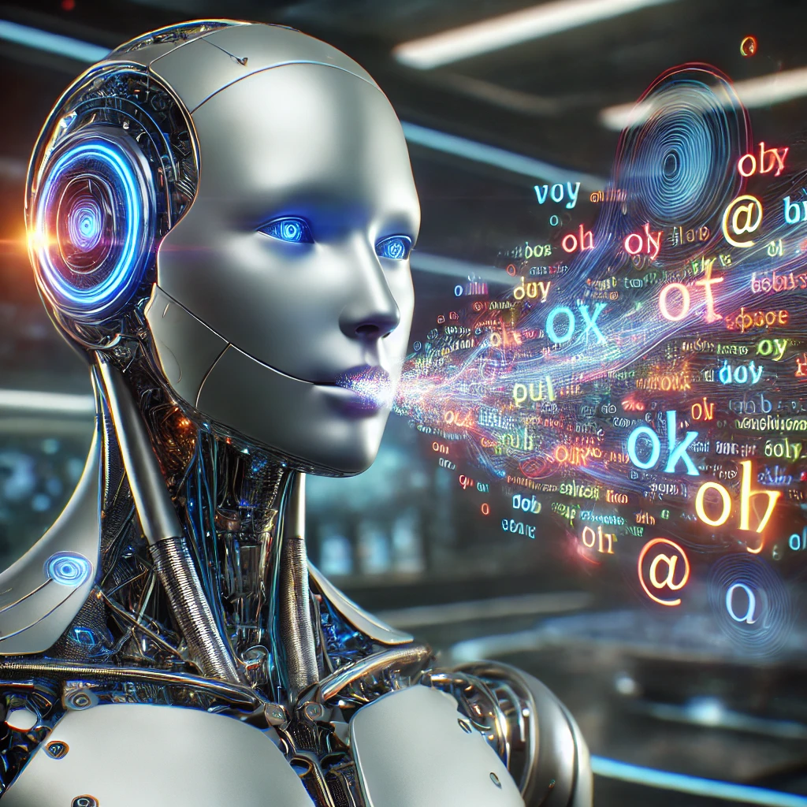
Dance with words
Diagram as code
Mermaid js Diagrams
Sequence Diagram
State Diagram
Simple flowchart
ER diagram
Mindmaps

Slide 16
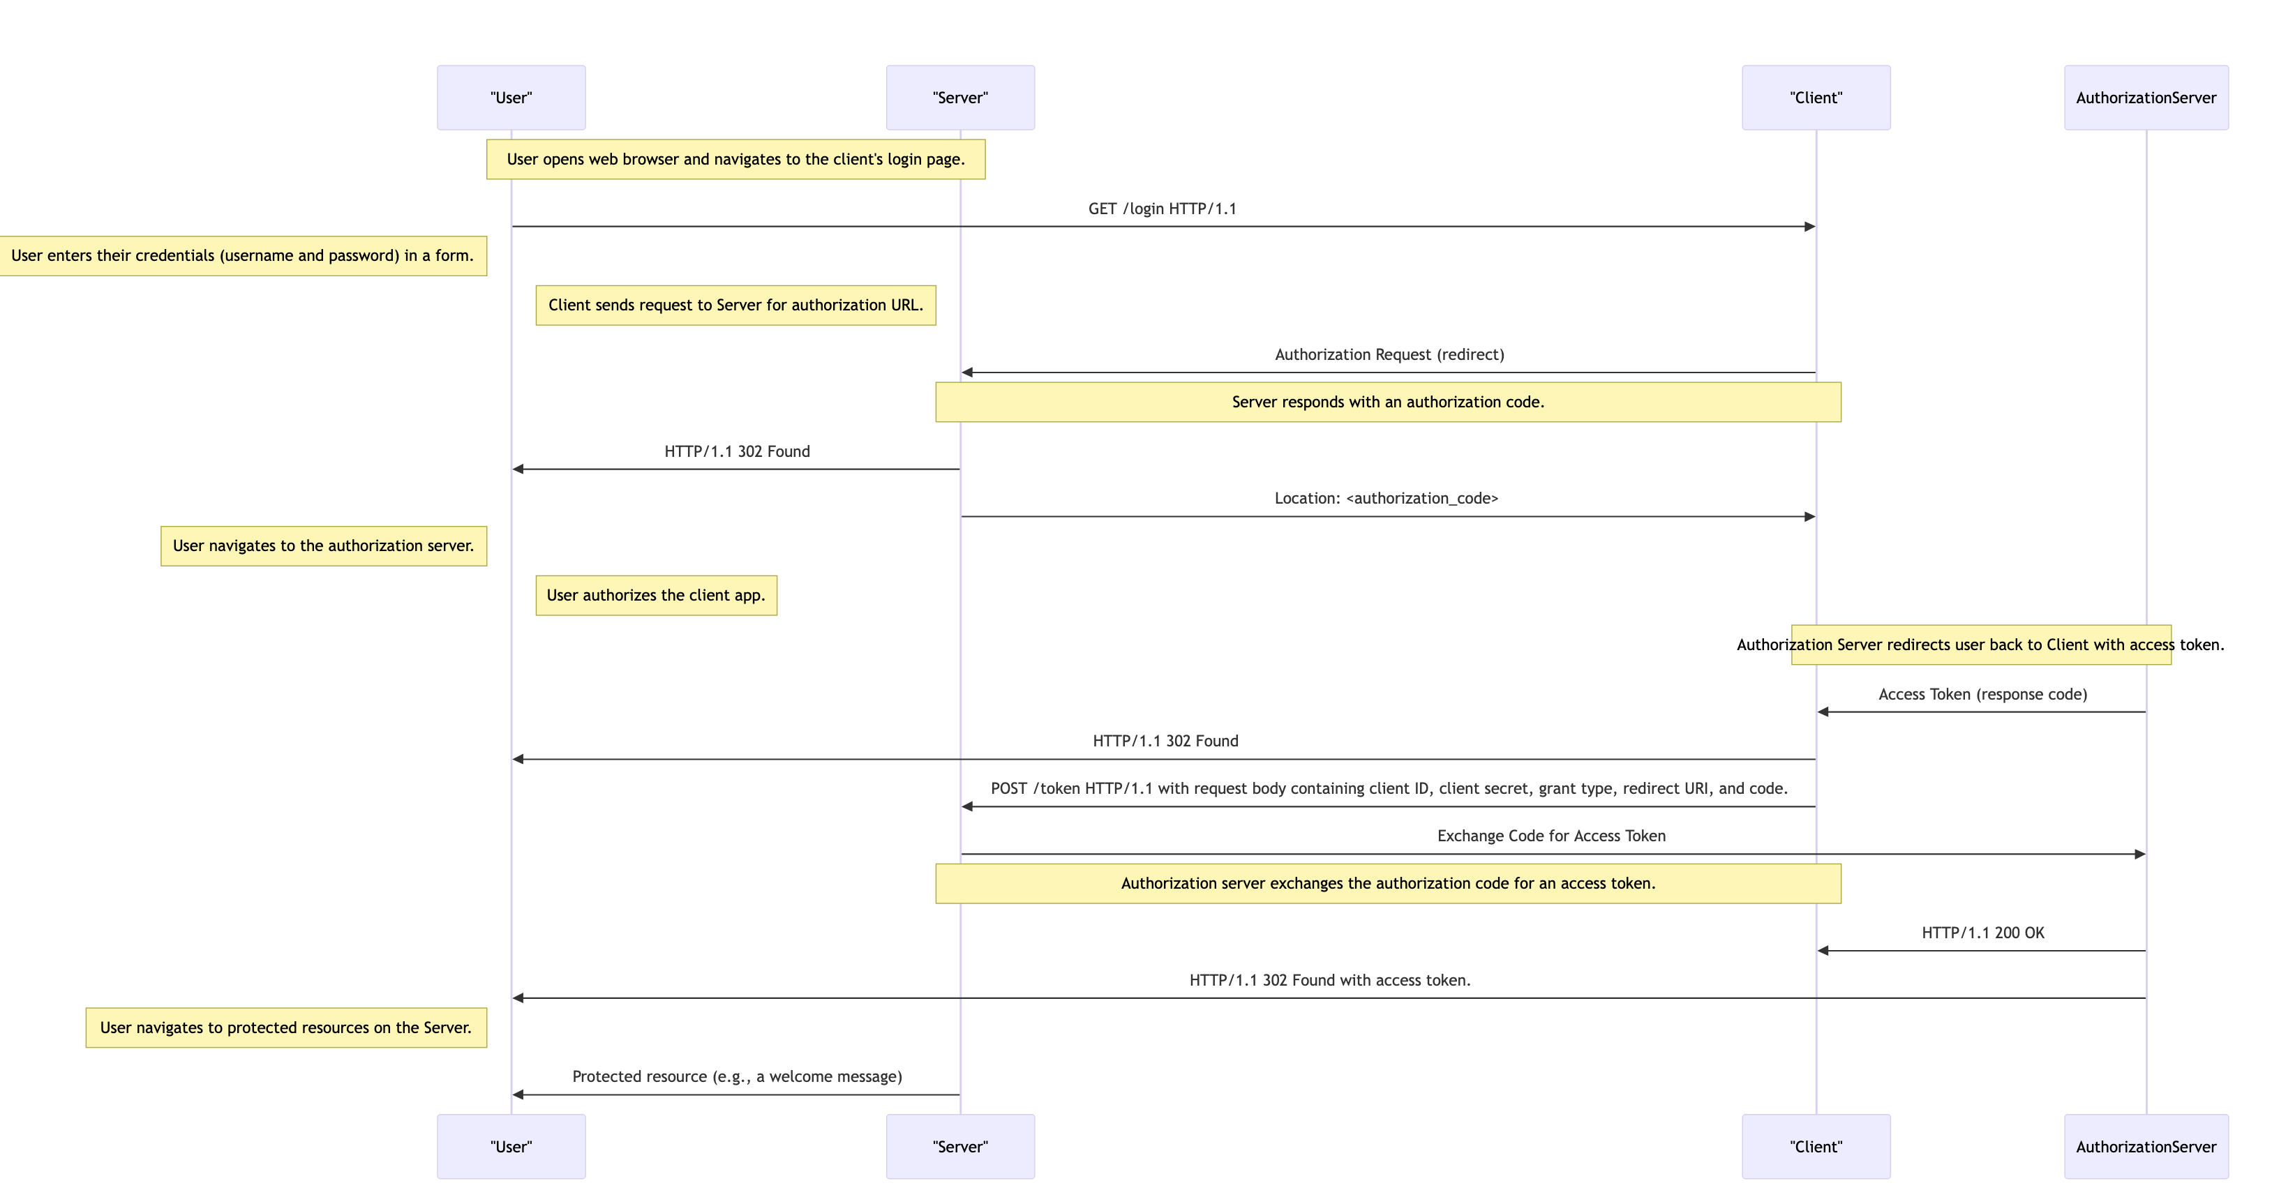
Generative AI Capabilities- Diagram as code

Slide 17
Generative AI
Quality
speed
price

Slide 18
Generative AI Comparison
Source : https://artificialanalysis.ai/

Slide 19
Generative AI Locally
Set up Ollama Locally
Docker container
Install Binary
Run Ollama on the terminal
Common commands
Start and Stop
Open Web UI
Local installation with docker
Generative AI locally + VS Code
N8N
What is N8N – sneak peak
Install using docker

Slide 20
Generative AI Locally
Ollama
Local AI platform to run and customize Large Language models
How to set up Ollama locally:
Download and install https://ollama.com/
Set up using Docker :
docker run -d --name ollama -p 11434:11434 \
-v ollama_volume:/root/.ollama ollama/ollama:latest
Reference :
https://collabnix.com/how-to-setup-ollama-with-ollama-webui-using-docker-compose/
https://collabnix.com/getting-started-with-ollama-and-docker/
Command to run the contain in the background
network port the container is exposed Host: Container
map the local drive to container storage
Image name from docker hub

Slide 21
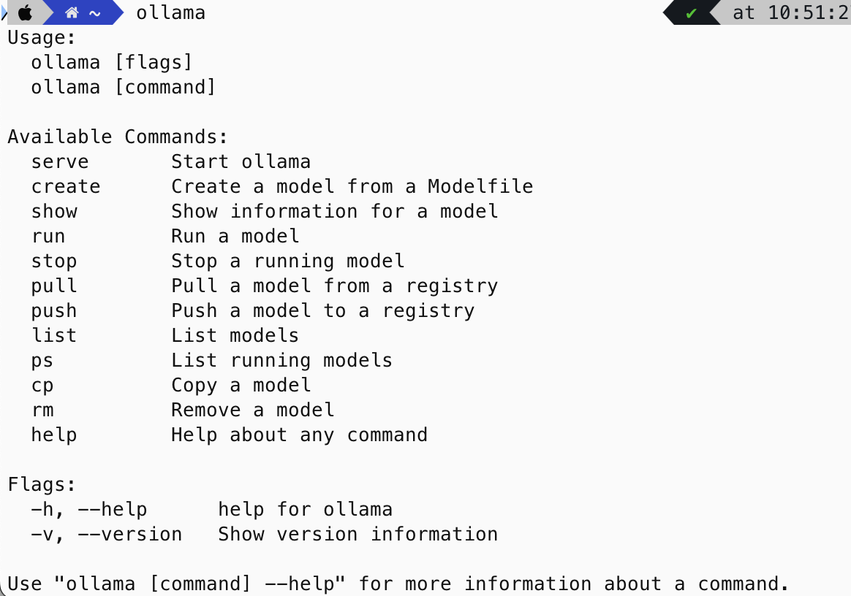
Generative AI Locally
Run Ollama in the terminal
Interface Ollama with a web app (open web UI)
Detailed set up Open web ui using docker container
https://collabnix.com/getting-started-with-ollama-and-docker/
Set up Open Web UI by installing locally
https://docs.openwebui.com/

Slide 22
Generative AI Locally
Choose the Gen AI End point : Locally or on the Cloud
Working with LLM’s in:
Download a model
Create a model
Delete a model

Slide 23
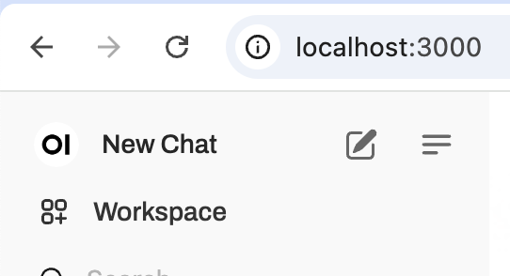
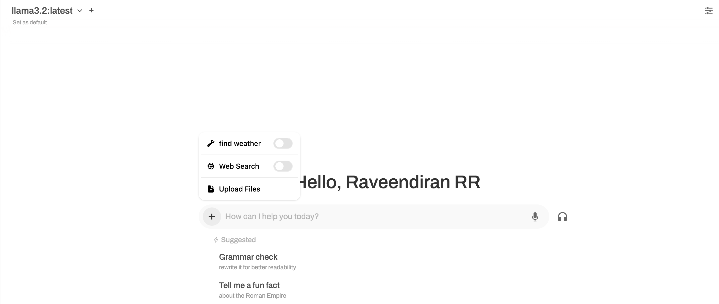
Generative AI Locally

Slide 24
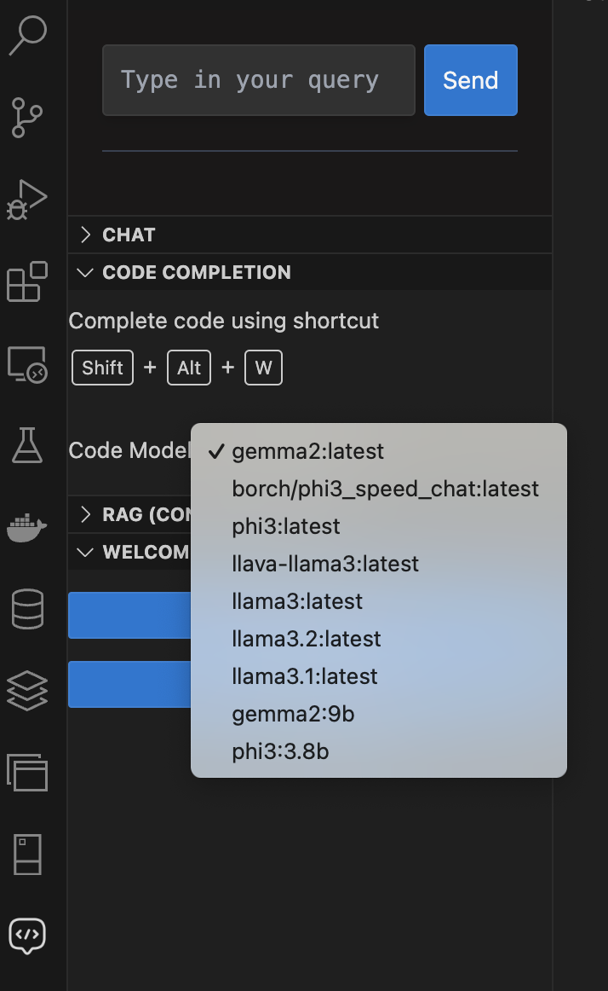
Generative AI Locally
Use vscode plugin to generate code using the local LLM
https://marketplace.visualstudio.com/items?itemName=nr-codetools.localaipilot

Slide 25
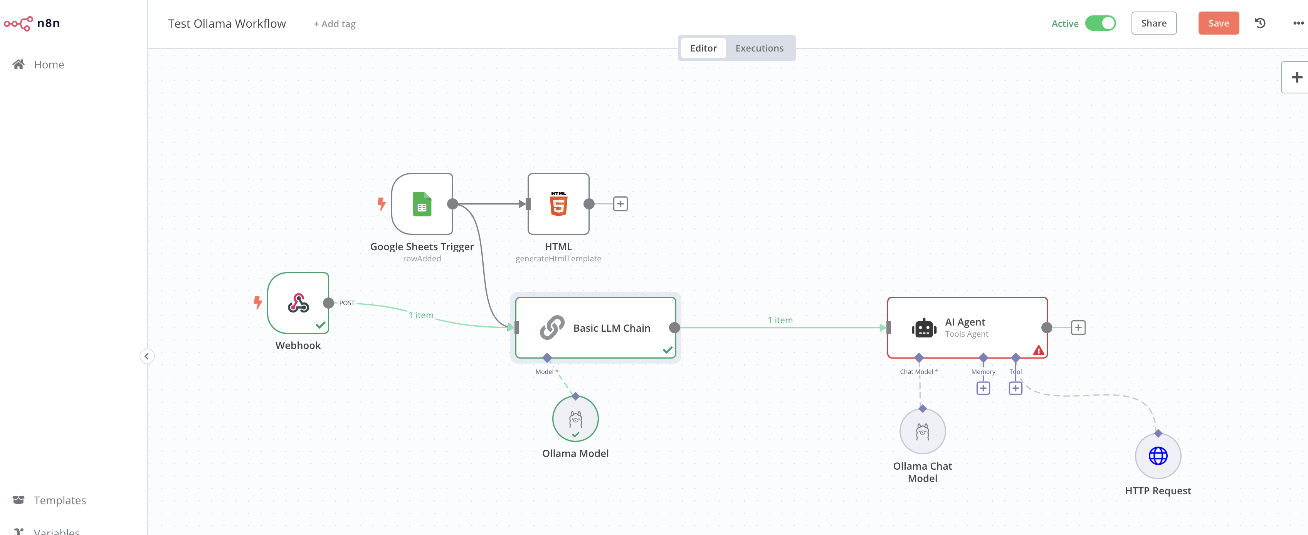
Automate locally
n8n is an open-source workflow automation platform enabling users to connect apps, automate tasks, and build custom integrations effortlessly.

Slide 26
Automate locally
Install n8n locally using docker
docker run -it --rm --name n8n -p 5678:5678 \
-v ~/.n8n:/home/node/.n8n \
docker.n8n.io/n8nio/n8n
Command to run in interactive mode
Port Number where the n8n runs host: container
Volume where the data for the container is stored
Container image form dockerhub

Slide 27
Raveendiran RR
Over 18 + years of overall experience in the IT Industry
Roles :
DevOps | App Development| CoE | Low-code No-code| SAP BTP | SAP Build Apps | Chatbots | Project management | SAP ERP/SuccessFactors support +Implementation | Generative AI | Machine Learning
Passionate about technology and innovation
LinkedIn

